Slide 1
Anesthesiologie voor morbied obese patienten
1150 1850 1947 1977 2010
J P Mulier MD PhD
Sint Jan Brugge-Oostende
Praktische aspecten
Bariatrische Anesthesiologie
Hoe outcome verbeteren

Slide 2
Complications in SOS measured in 1164 surgery patients
Total mortality bariatric surgery: 0.5 to 2 %
Postoperative complications: 13 %
pulmonary complications VAP only 6.1 %
versus 1.5 % non bariatric surgery
other complications 4.8
leakage, abscess 2.1
wound complications 1.8
thrombosis, embolism 0.8
bleeding 0.5
Complications required reoperation in 2.2 % of the patients.
Reoperations and conversions over 10 years:
Banding 31 %
VBG 21
Gastric bypass 17
SOS Sjostrom N Engl J Med 2007

Slide 3
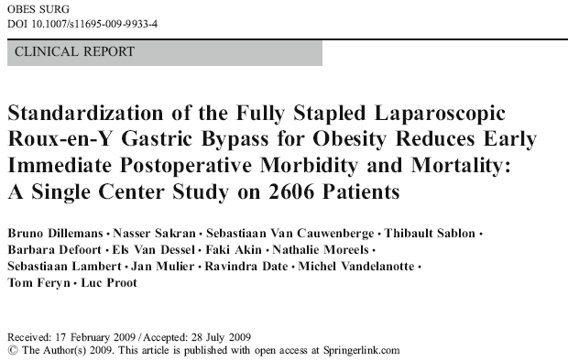
Our Results in lap RNY

Slide 4
How can the anaesthesiologist help to reduce morbidity?
post op leak prevention
  leaktest
post op bleeding prevention
  SAP rising
post op pneumonia prevention
  Taperguard gel weaning fast
Surgical time shortening?
  Give surgeon laparoscopic workspace
Turnover time shortening?
  Accelerate awakening without complications
‘Ask not only what the surgeon can do for you, ask also what you can do for your surgeon.’
Transdisciplinary work

Slide 5
Can anesthesiology help to prevent leak? yes
Visualize leak for the surgeon
  We use a high volume load test
  Occlusion distal by surgeon, rapid injecting 150 ml blue water till gastric pouch distend and fluid leaks out between staple lines. Rapid air injection with staple lines under water?
Ensure good gastric perfusion to visualize ischemia zones

Slide 6
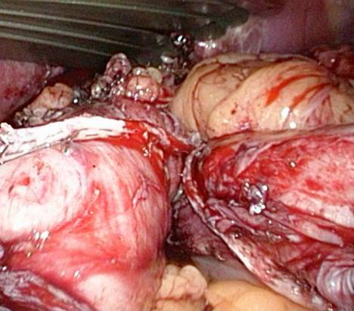
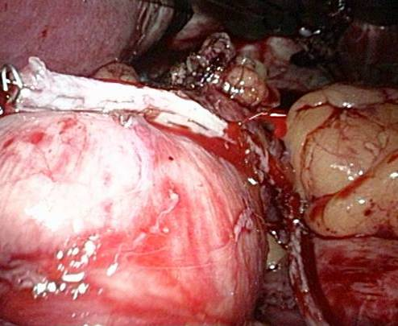
Can anesthesiology help to prevent post op bleeding? yes
110/57 145/78
J.P.Mulier, B Dillemans, G Vandrogenbroek, F Akin
The effect of systolic arterial pressure on bleeding of the gastric stapling during laparoscopic gastric bypass surgery.
Obes Surg 2007; 17: 1051

Slide 7
Immediate post operative treatment of bleeding
Most frequent complication:
  Bleeding intra-intestinal or extra-intestinal
  Control Hb
  Know signs of hypovolemia:
    tachycardia
    low diastolic pressure
    Blood pressure variation
Diagnosis by suction catheter immediate before extubation
Rince Ice water through gastric tube for intra luminal bleeding
Plasma expanders - Transfusion of blood
Gastroscopic coagulation of intra-intestinal bleeding
Laparoscopic re intervention for extra-intestinal bleeding

Slide 8
Bleeding prevention
Control of extra luminal bleeding
  Elevation of blood pressure at end of procedure > 140 SAP
Obes Surg 2007; 17: 1051
Control of Internal bleeding is difficult
  Post op gastric tube aspiration
  Ice water rinsing in gastric tube
Elevation of blood pressure during stapling ?
In 2008, 2009 number of reinterventions dropped.

Slide 9
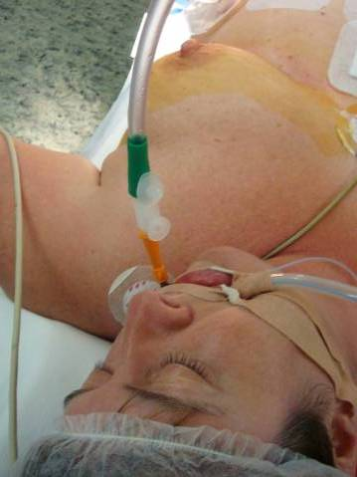
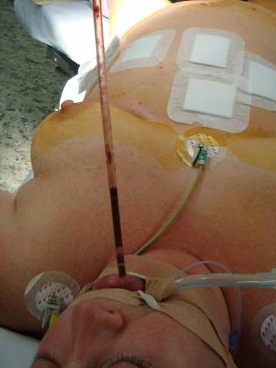
Post op gastric tube aspiration test
Treat if new red blood detected
Empty stomach pouch to prevent aspiration

Slide 10
Can anesthesiology help to prevent post op pneumonia? yes
Safe induction
Safe endotracheal tube
Safe extubation
  ERAS: early recovery after surgery
  Short awakening to full awake,
  Rapid decurarisation till full muscle force

Slide 11
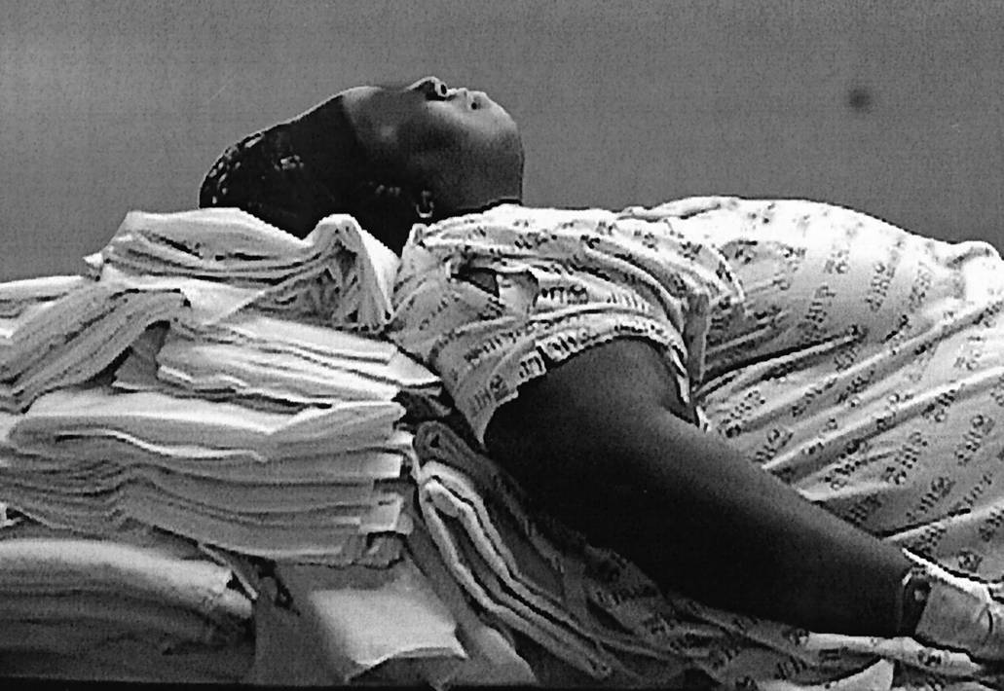
Safe induction
Brodsky: obese patients: difficult in mask ventilation
No difference in difficult intubation if properly positioned.
Brodsky, J. B. et al. Anesth Analg 2003;96:1841-1842-a
Figure 1. A morbidly obese patient will be in position for direct laryngoscopy when an imaginary horizontal line can be drawn from the sternal notch to the external auditory meatus

Slide 12
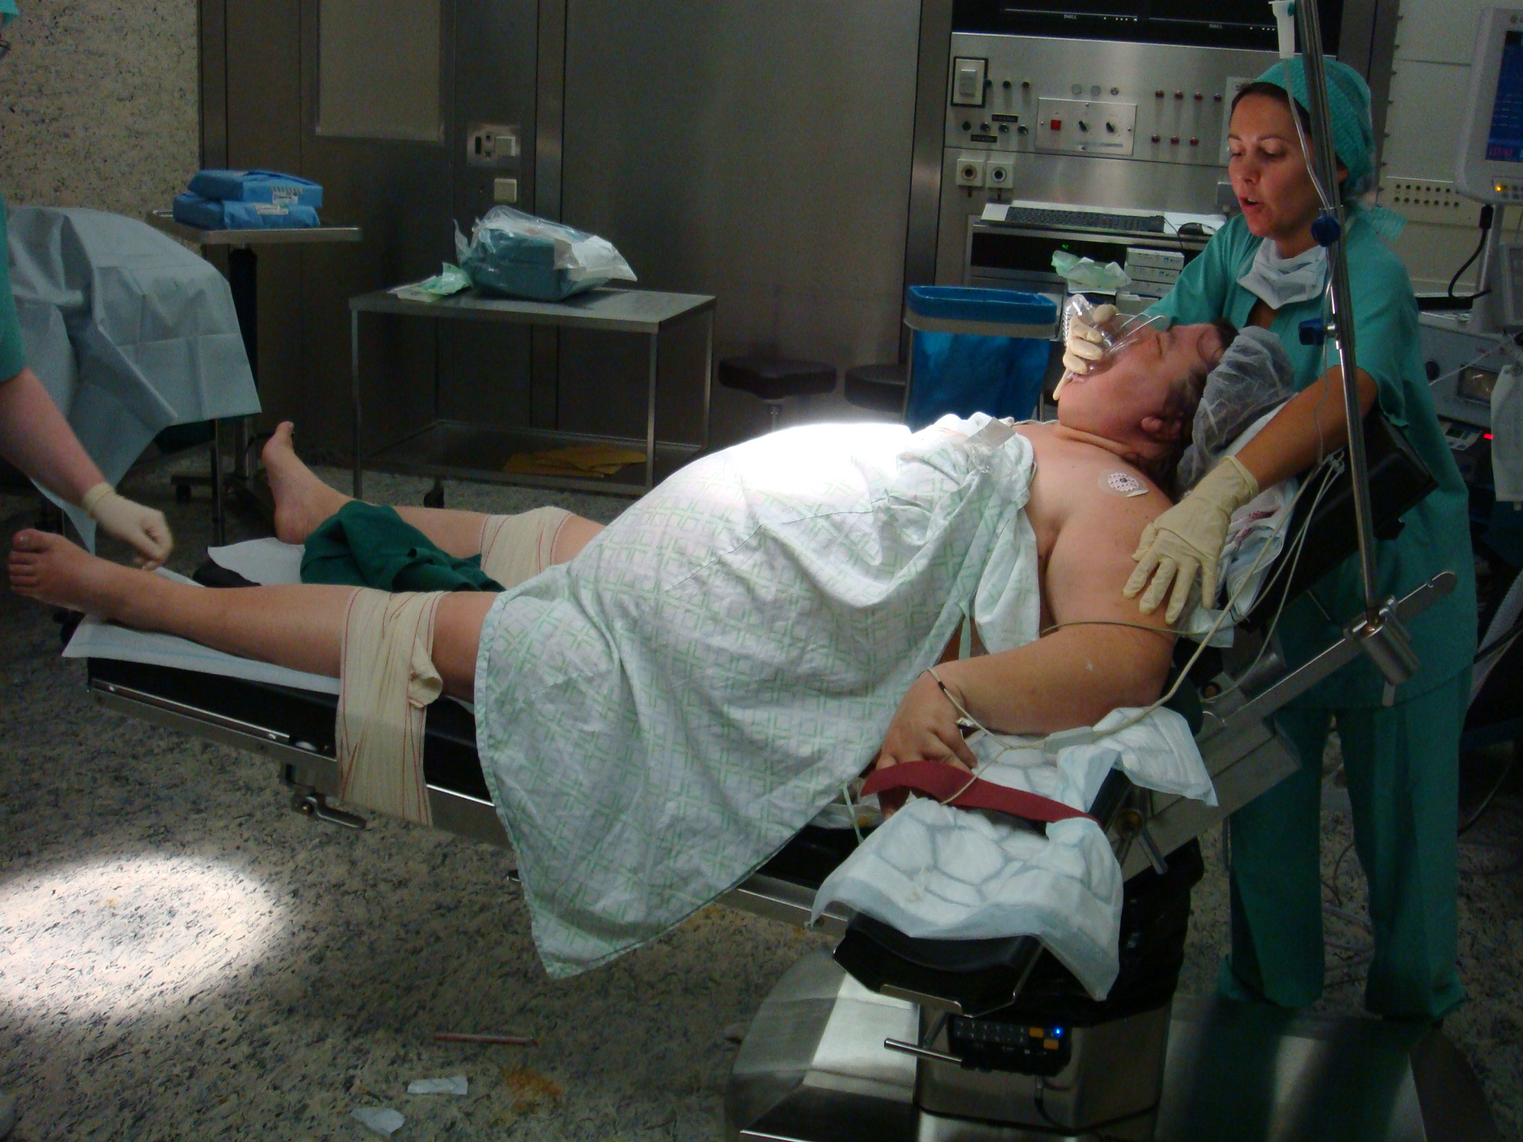
Full decurarisation to TOF 90% is important for morbid obese patients
Increased work of breathing
  Larger minute volume
  High intra abdominal pressures
Insufficient force to breath
  Less muscle
  More friction
Sitting up at induction and at awakening helps

Slide 13
Intubation is not difficult if… difficult mask ventilation = difficult intubation
Proper positioning normalizes the risk of difficult intubation. ( Brodsky)
Trachea pharyngeal alignment by
  Head pillow
  Thorax elevation
Use of an inflatable pillow, safety bird is simple and effective to rotate thoracic column.
Mask ventilation is more difficult
Copyright restrictions apply.

Slide 14
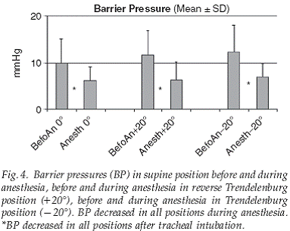
Is mask ventilation safe in morbid obese patients?
A deLeon
Body position and esophageal sphincter pressures in obese patients during anesthesia
Acta Anesth Scand 2010

Slide 15
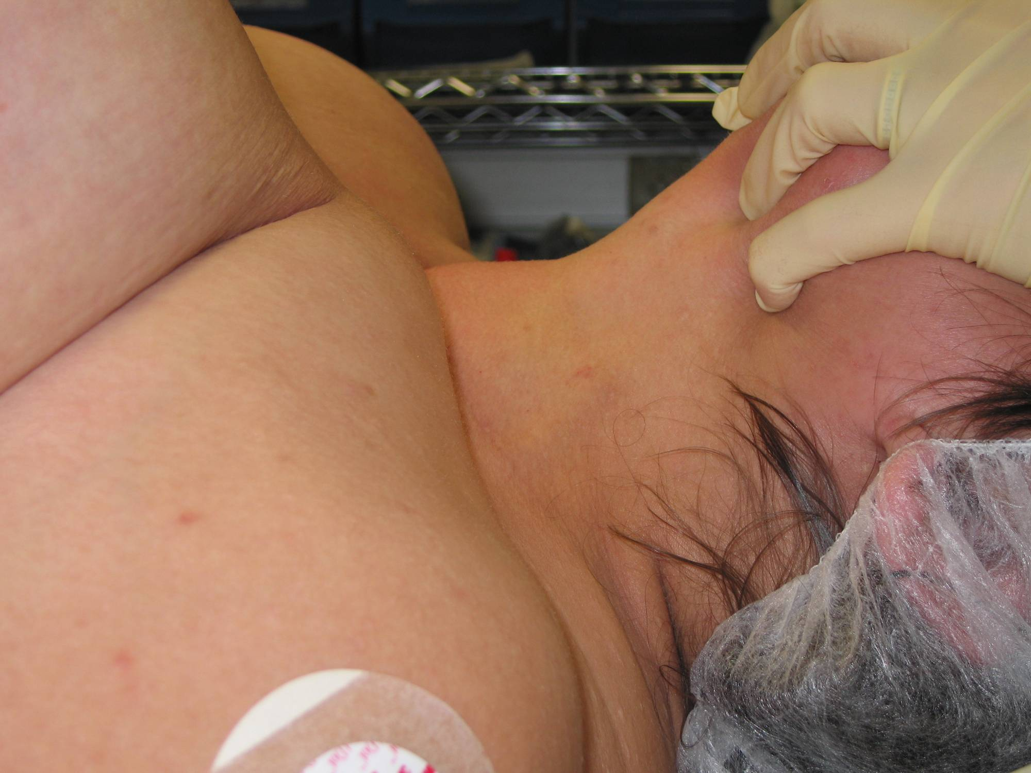
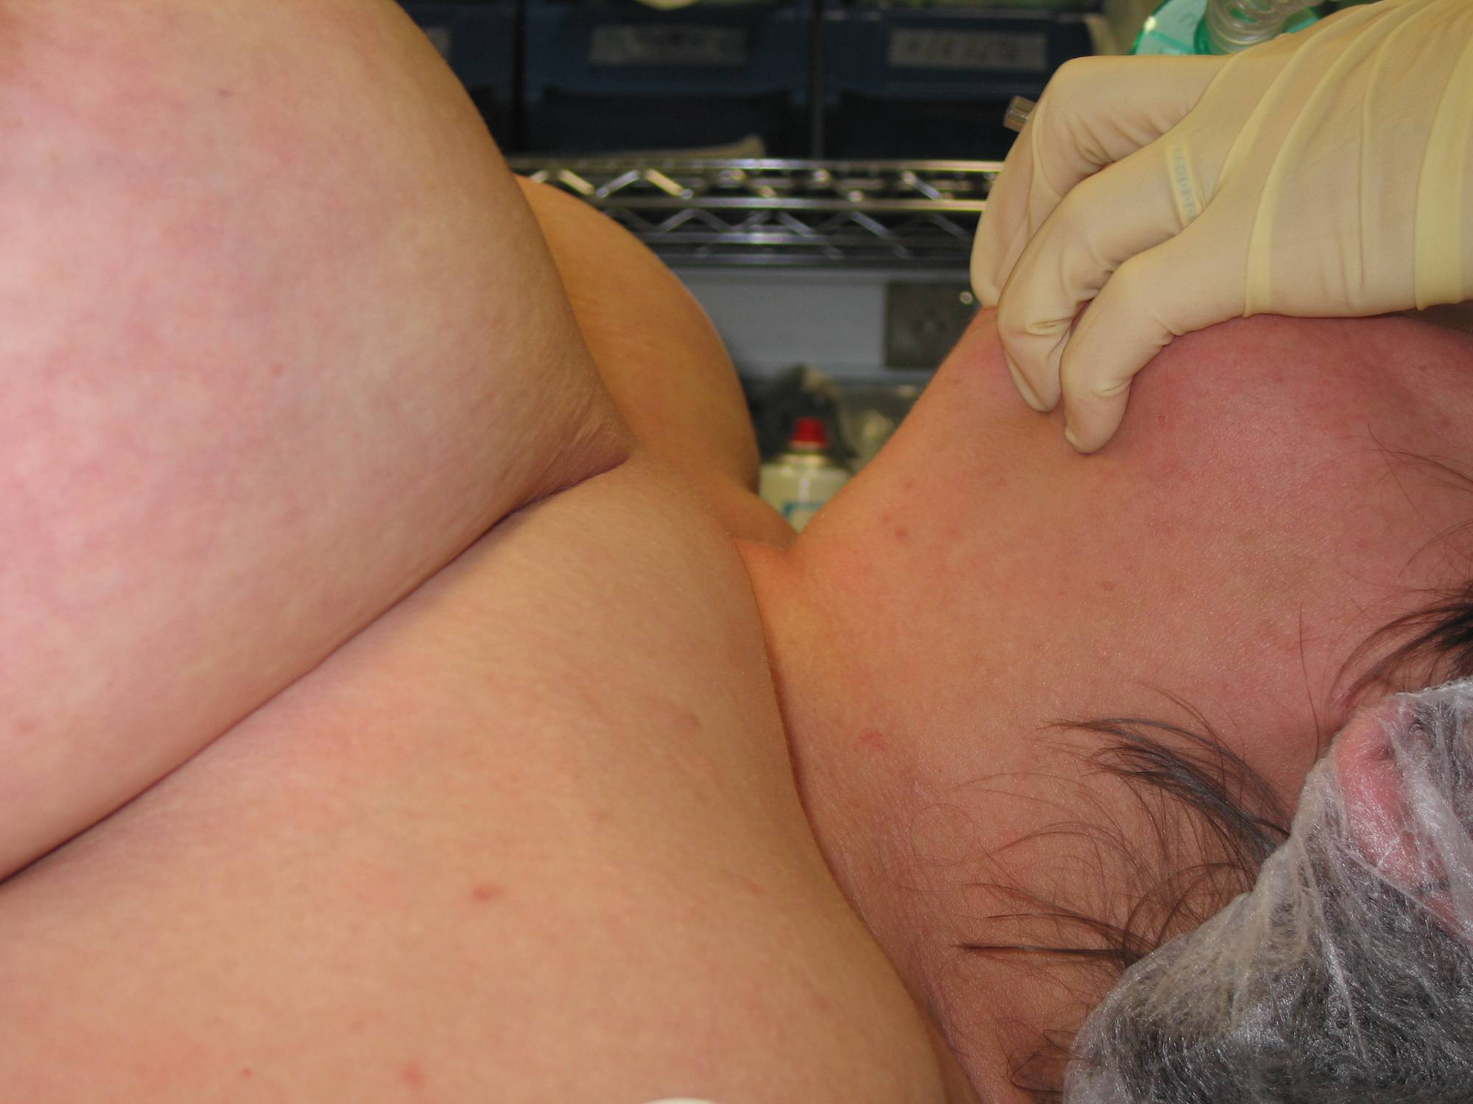
Sterno mental distance without safety bird
Sterno mental distance
Normal position
Use of inflatable pillow
Mulier J.P., Dillemans B. Intubation time with and without inflatable intubation device
Eur J Anesthesia 2007 Suppl

Slide 16
Effect of inflating safety bird on SM distance vs BMI
Mulier J.P., Dillemans B. Sternomental distance with and without inflatable intubation device
Am Soc Anesthesia 2006

Slide 17
Is mask ventilation safe in morbid obese patients?
Intra abdominal pressure correlates with BMI
  J P Mulier EJA 2009
Abnormal reflux scores correlates with BMI
  Fisher B. Dig Dis Sci. 1999
But, LES pressure increases faster than gastric pressure: active contraction at the esophagogastric junction
  R Mittal Am J Physiol Gastrointest Liver Physiol 1990
Even after fasting is gastric content not zero

Slide 18
Oral disinfection
Non sterile intubation conditions
Oral decontamination for prevention of pneumonia in mechanically ventilated adults: systematic review and meta-analysis.
  E Chan. BMJ 2007; doi: 10:1136/bmj.39136.528160
    Oral decontamination reduces incidence of VAP
    Neither AB nor anti septic oral decontamination reduces overall mortality of mech ventil or stay in intensive care.
Gargling with povidone-iodine reduces the transport of bacteria during oral intubation.
  O Junichi. Can J Anaesth 2004; 51: 932-6
Teeth brushing 5 x Day pre op reduces mortality
    Y Akutsu. Surgery 2010; 147: 497

Slide 19
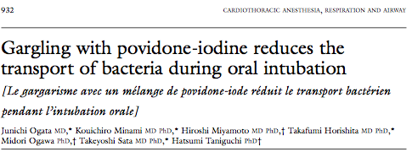
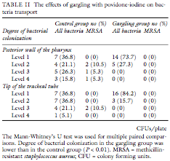
Number of colonies
Number of patients

Slide 20
Respiratory distress in morbid obese
increased work of breathing,
increased oxygen consumption,
ventilation perfusion mismatch
  mean AaDO2 is 4 times higher
impaired gas exchange
  PaO2 is lower
All lung function tests decreased
  Fat impaired muscle, lung expansion,…
Every 5 kg reduction in weight increases the PaO2 by 1 mmHg

Slide 21
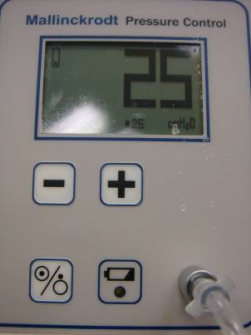
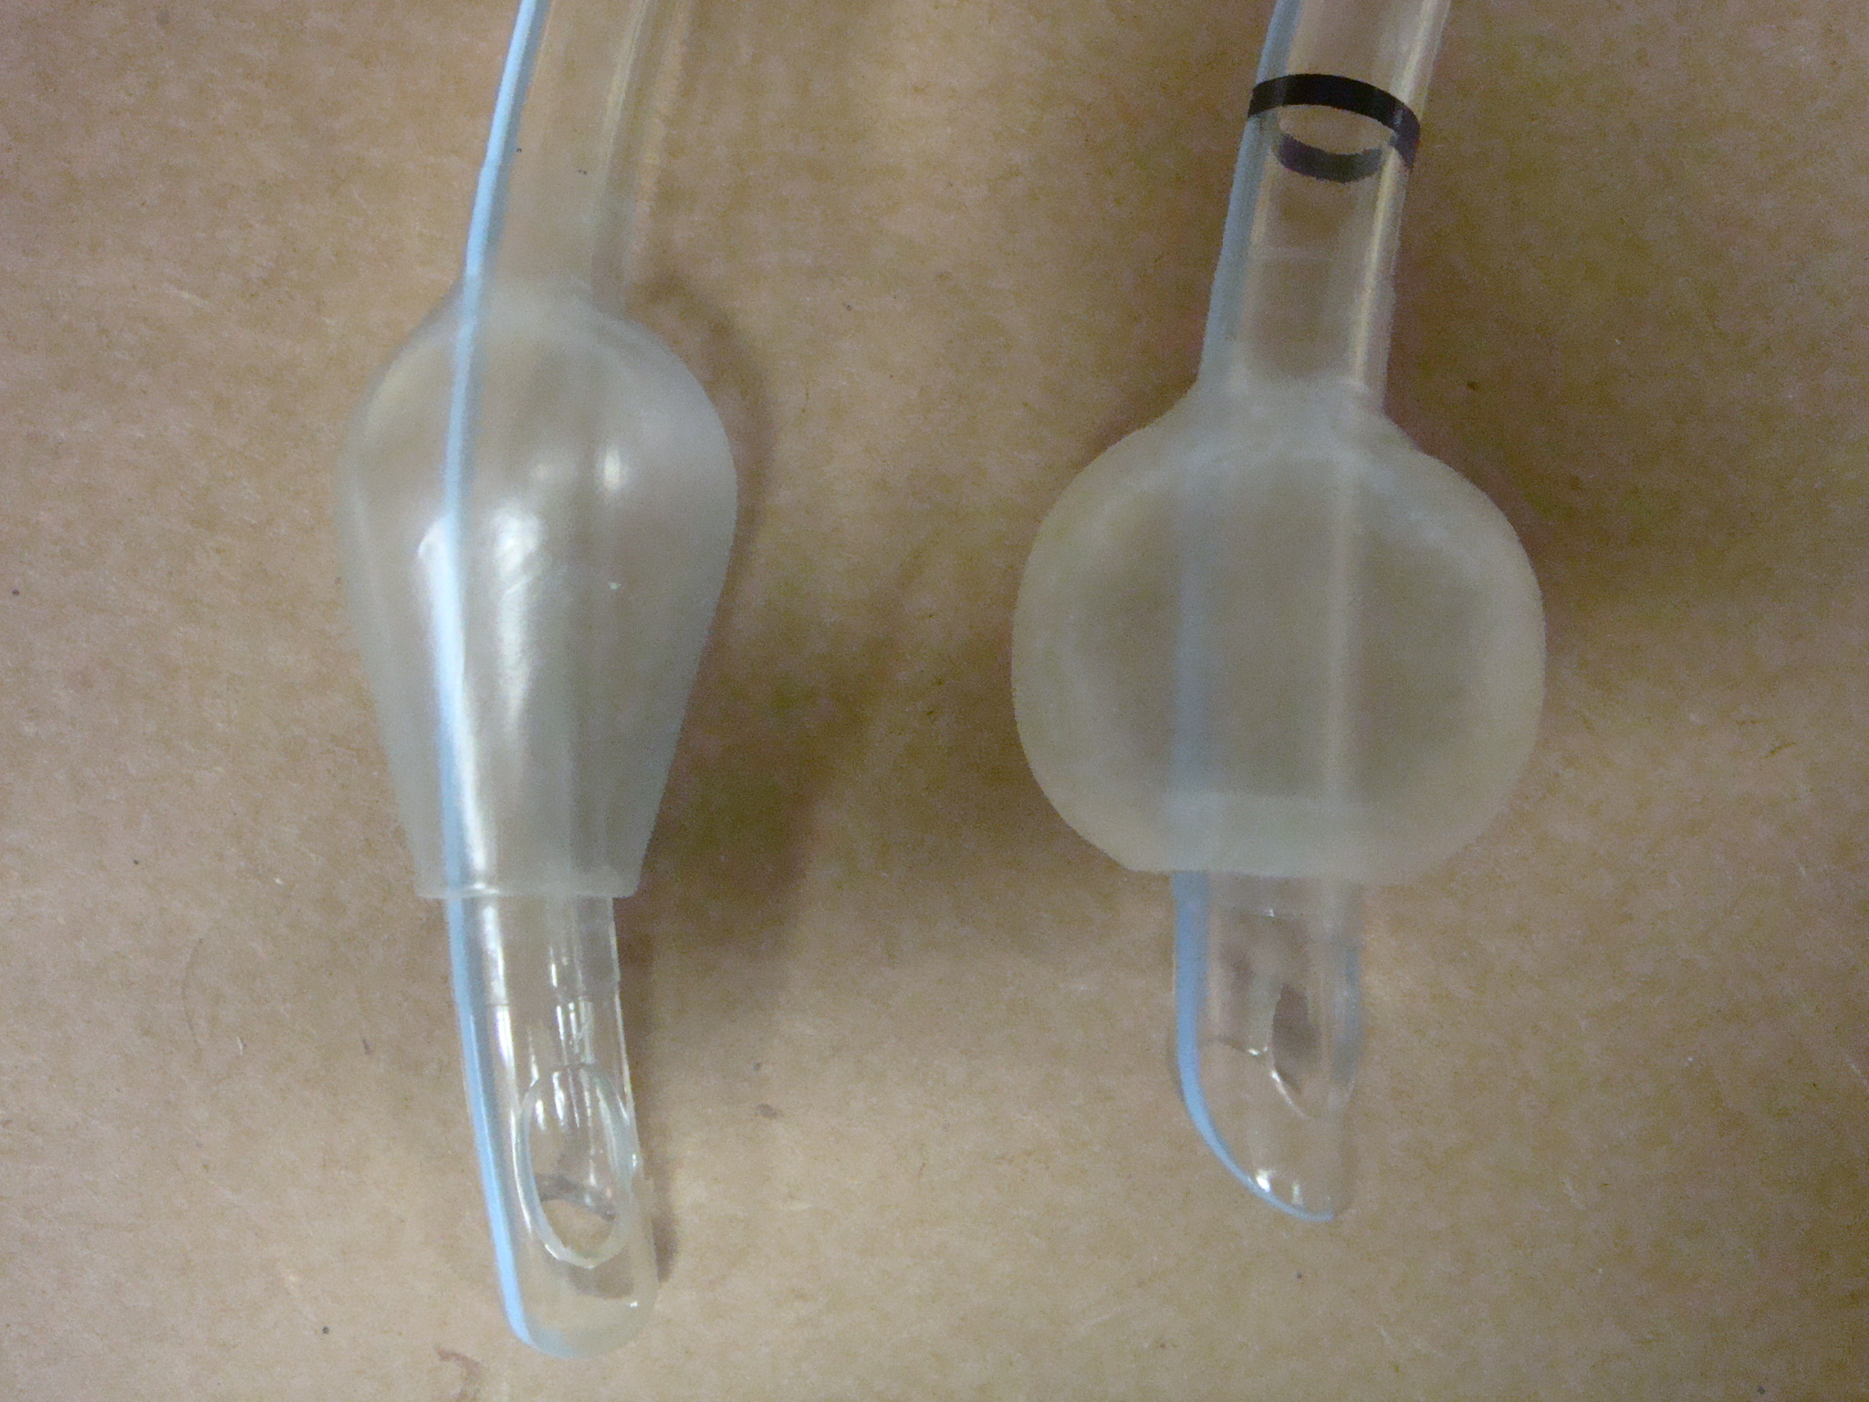
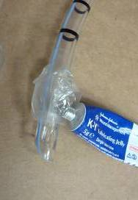
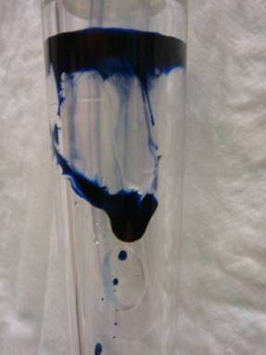
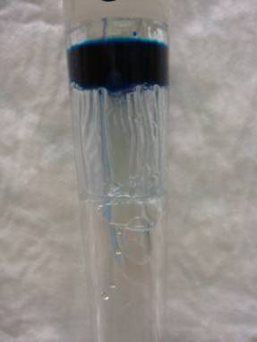
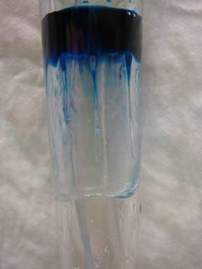
In vitro tests
A B C
Runs through stop on top runs & stop

Slide 22
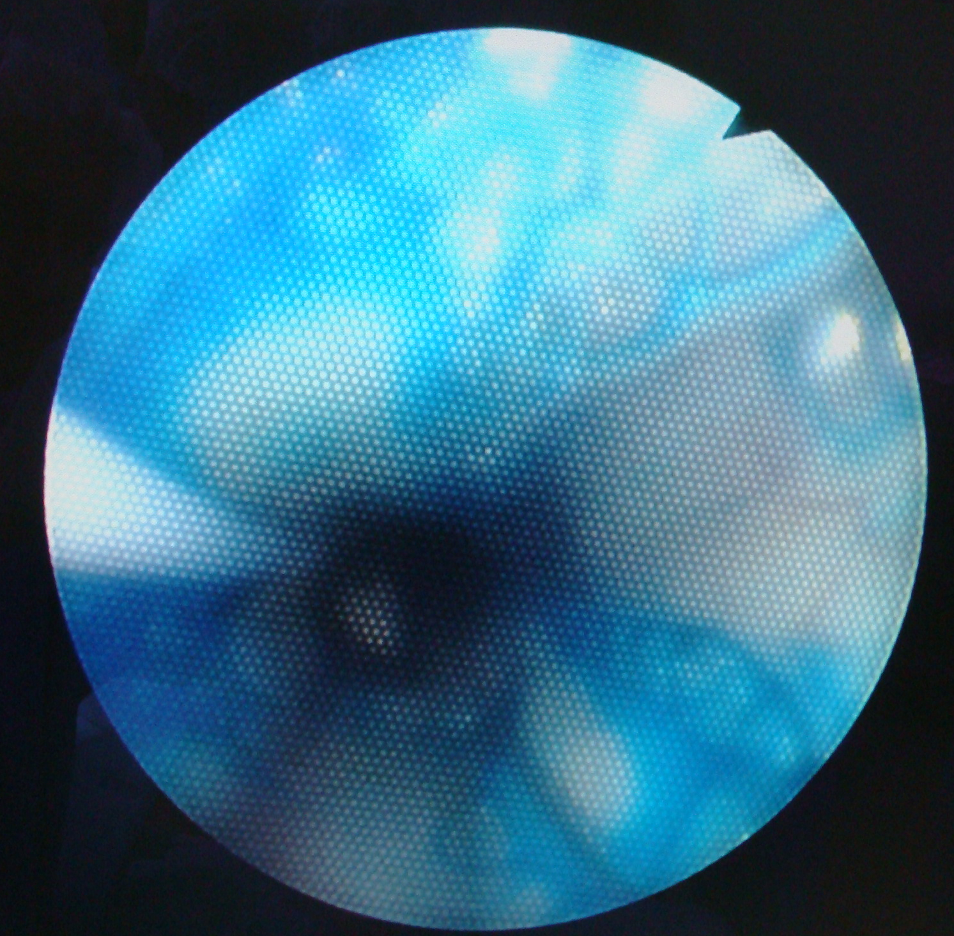
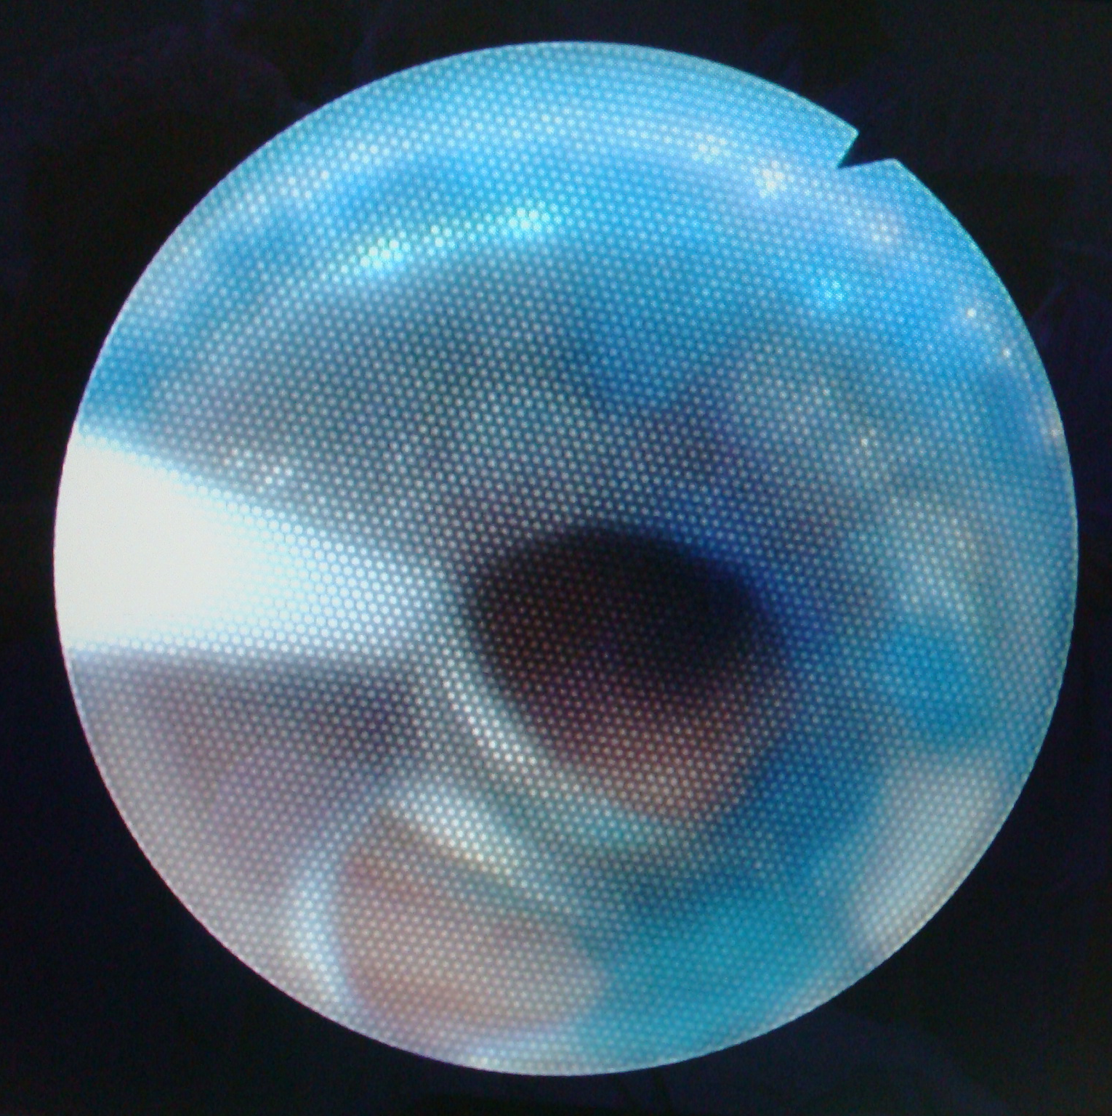
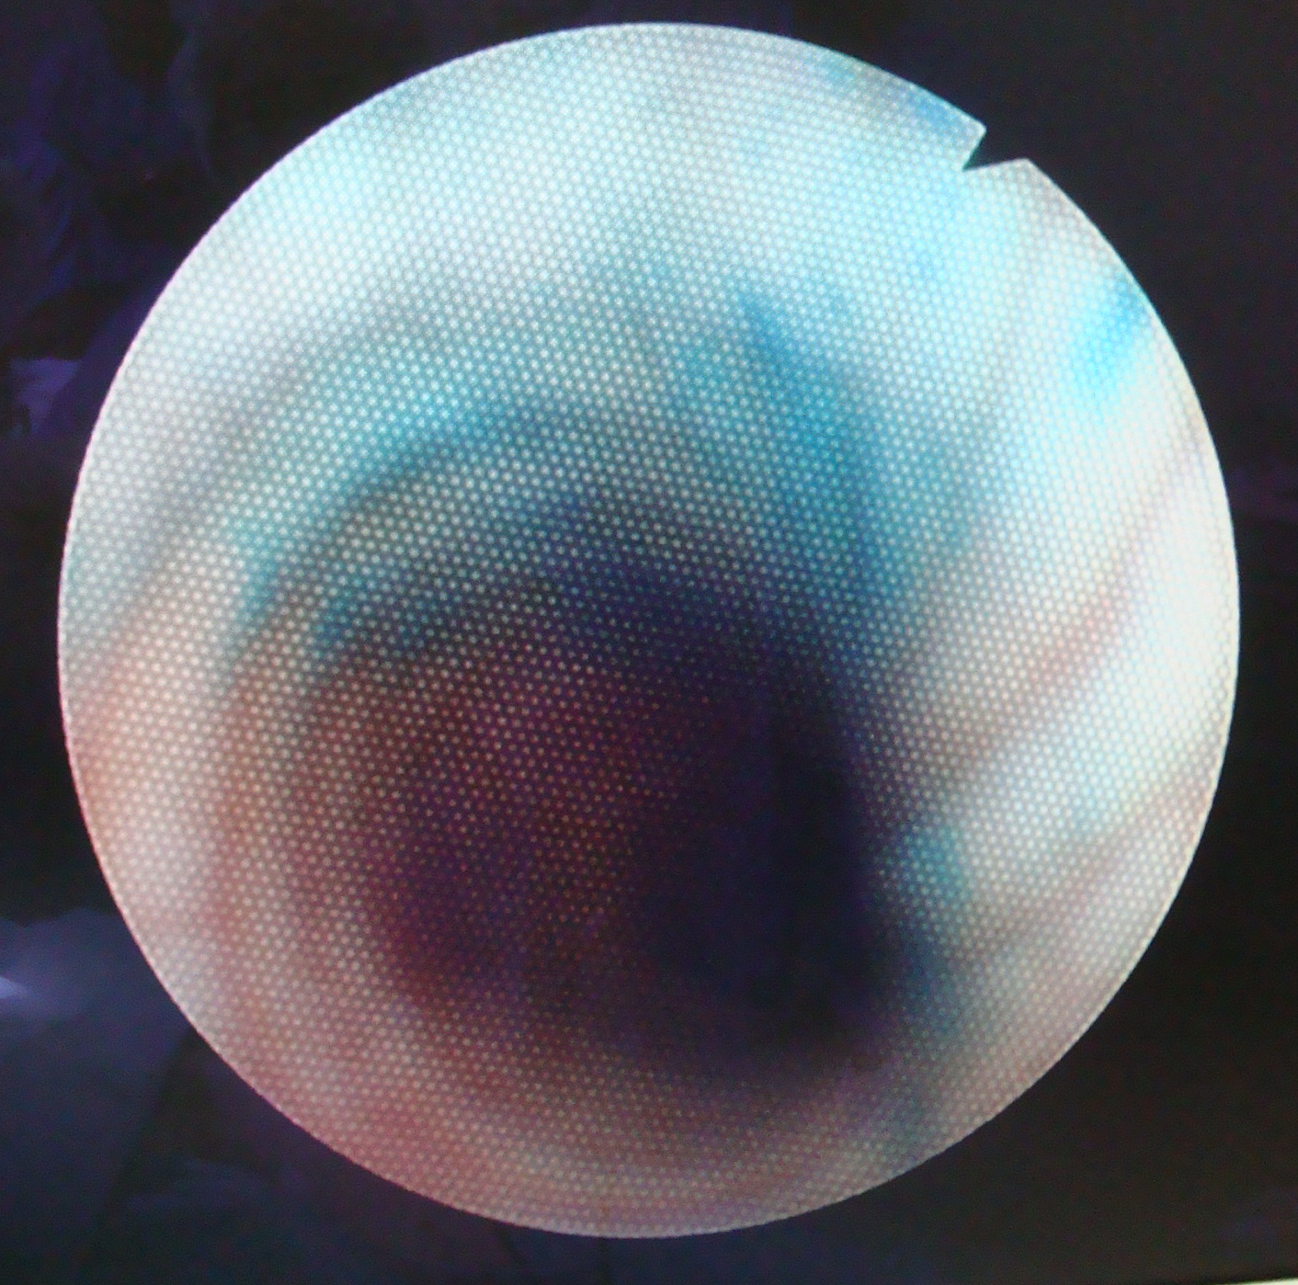
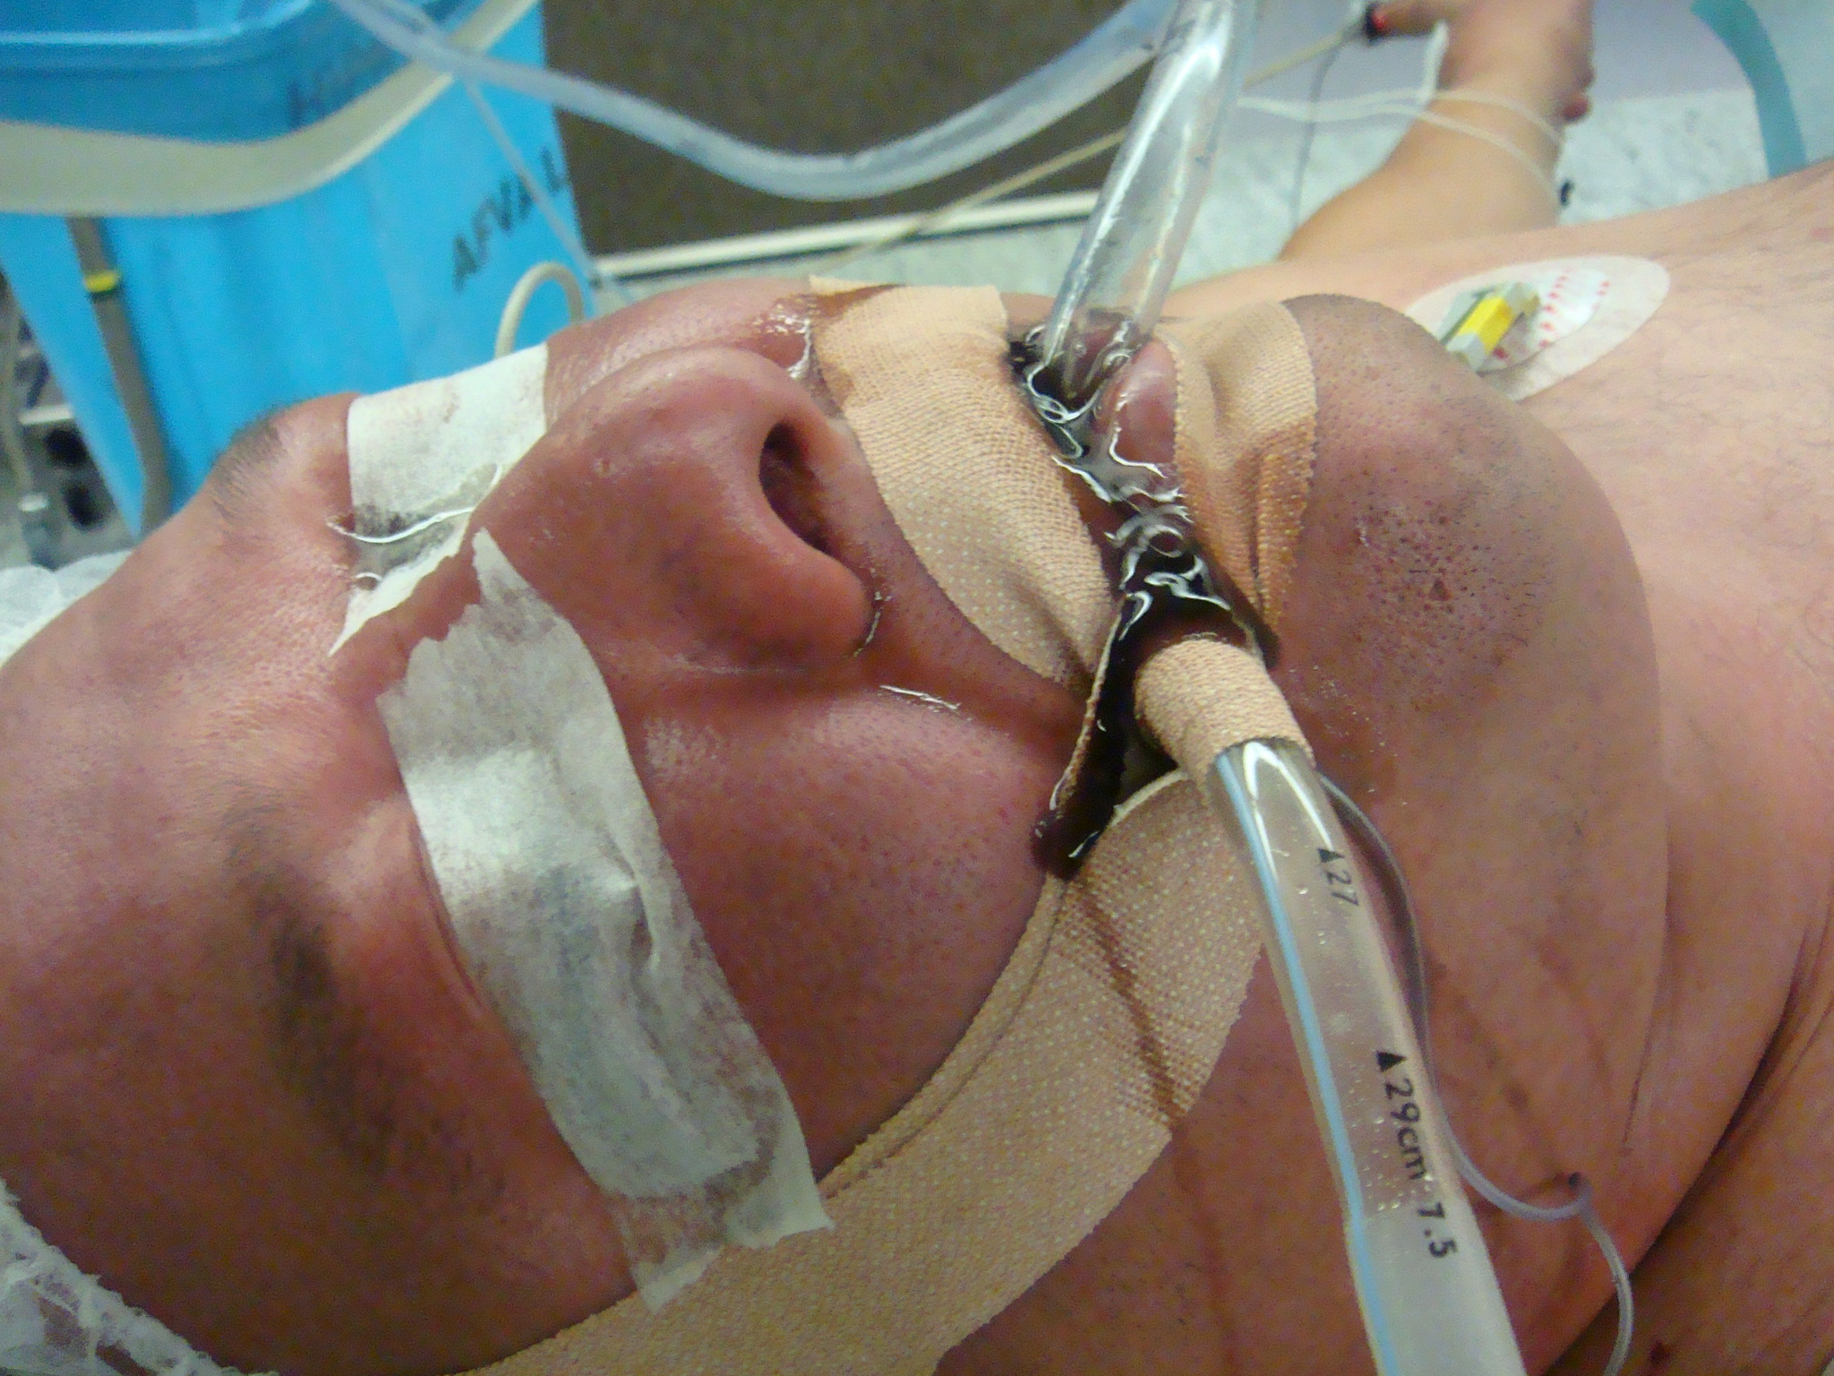
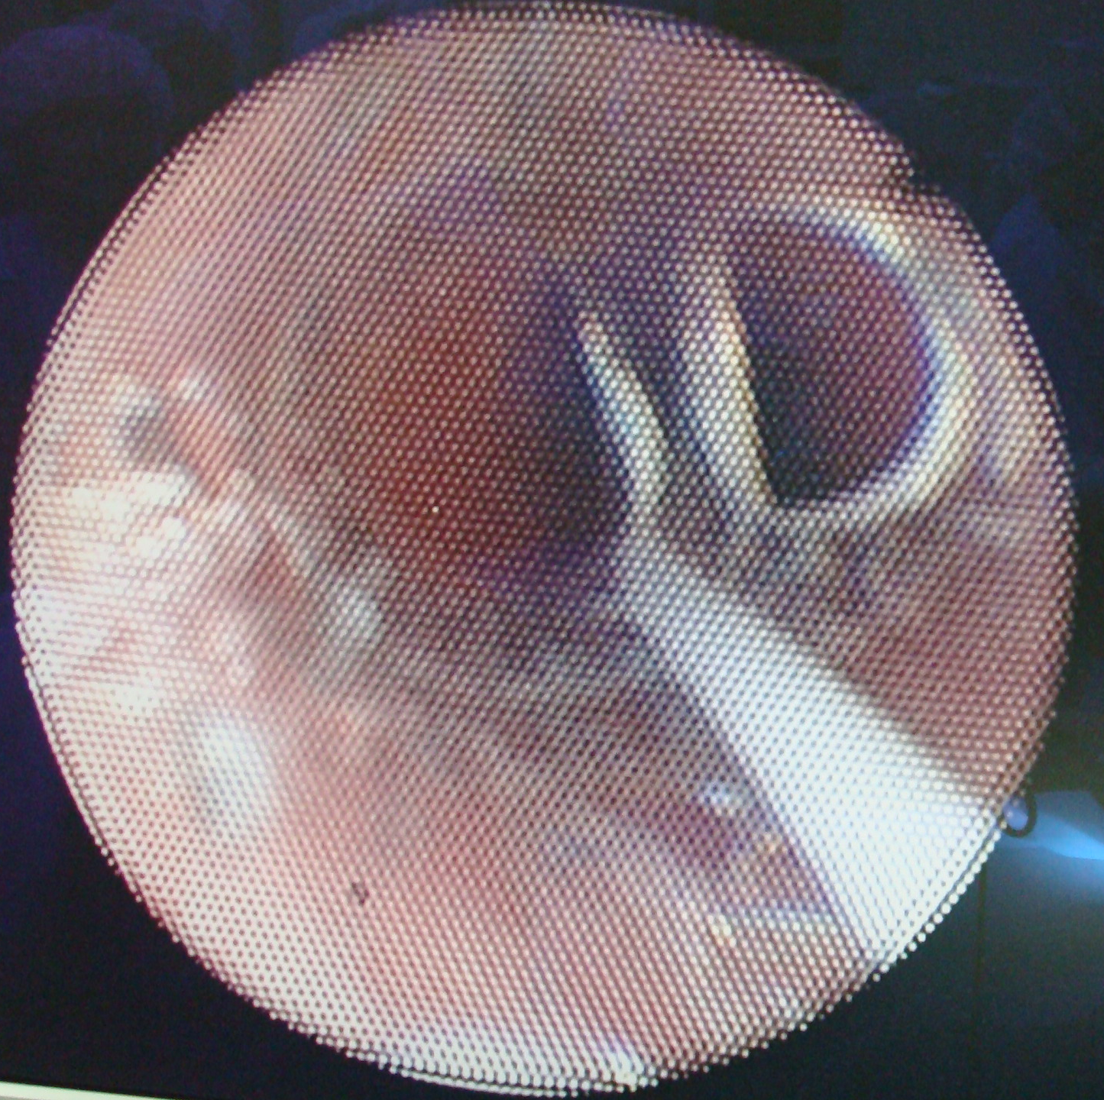
above cuff below cuff trachea
Hi Lo 6,5 cuffed ETT
below cuff Taperguard 6,5 cuffed ETT

Slide 23
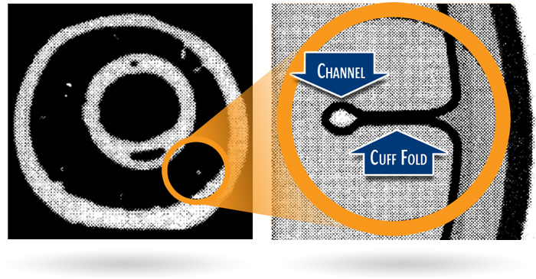
Excess Cuff Material Forming Folds and Channels
CT image of an inflated ETT cuff in a trachea model¹
LEFT: Full cross section of
intubated model trachea
RIGHT: Enlargement of region demonstrating a cuff fold and channel
1. Dullenkopf et al. Intensive Care Med. 2003;29:1849-1853.
Notes:
Here is an example CT scan showing the folds and channels as depicted in Dullenkopf et al. These folds and channels provide a pathway for microaspiration, which occurs quite frequently.

Slide 24
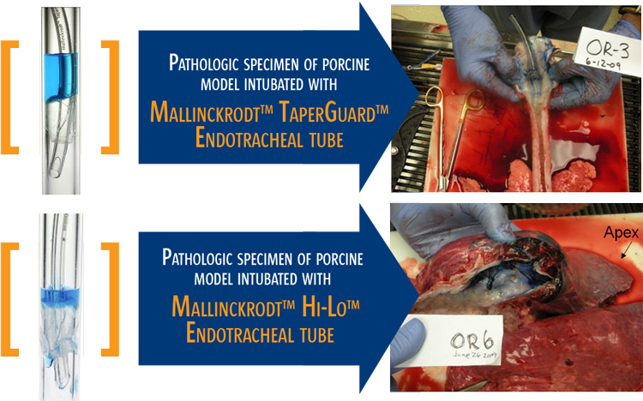
Microaspiration Can Cause Lung Injury
Notes:
This image was taken from a study in a porcine model undergoing abdominal surgery, intubated with a Hi-Lo™ Endotracheal tube. In this picture, 5 mL of blue dye was placed above the endotracheal tube cuff followed by positive pressure ventilation for 6 hours. The procedure was performed for both the MallinckrodtTM Hi-LoTM tube and the TaperGuardTM Endotracheal tube. In the former, fluid leakage occurred around the cuff prior to extubation allowing blue dye to descend into the respiratory tree. In the latter, no blue dye was visualized distal the cuff.

Slide 25
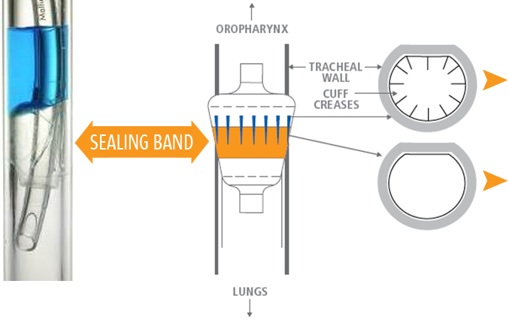
Altering Cuff Shape Allows for Better Sealing Characteristics
Proximal cuff:
Cuff diameter > Tracheal diameter
Sealing band (mid cuff):
Cuff diameter = Tracheal diameter eliminating excess cuff material locally
Mallinckrodt™ TaperGuard™ ETT
Notes:
Recent evidence shows that using a taper-shaped cuff on an endotracheal tube will allow the cuff to reach a common diameter with the trachea at some point between the oversized proximal and undersized distal edges. This middle portion of the cuff, where cuff diameter = tracheal diameter, should have little or no excess cuff material, and therefore minimize folds and channels. The observed decrease in microaspiration (see following slides) is believed to be a result.

Slide 26
Human Methylene blue leak test
Obese patients, CMV 5 peep after 5 minutes when blue is visible above cuff
9 patients excluded as no blue above cuff

Slide 27
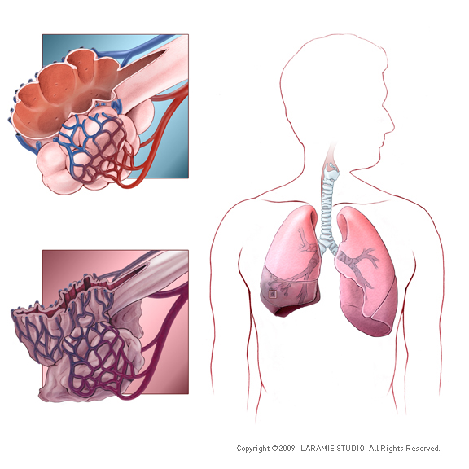
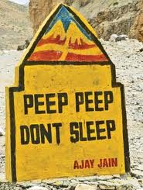
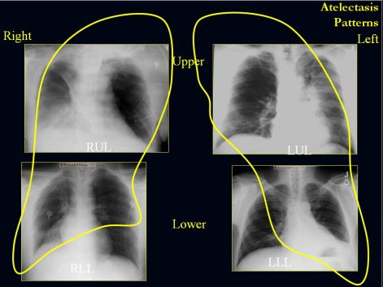
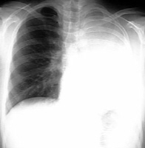


Do we need New Ventilation Modes?
Old problems not solved ?
  Atelectasis: peep & recruitment
  Synchronisation problems
New patient population? Extreme age, size
  Neonati - very old – surgery less invasive
  Morbid obese - anorexia
New insight in physiology?
  Volutrauma is more important than barotrauma
  Permissive hypercapnia, hypoxia instead of biotrauma
Measuring atelectasis
Attention & Awareness
Use of peep and recruitment

Slide 28
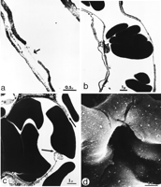
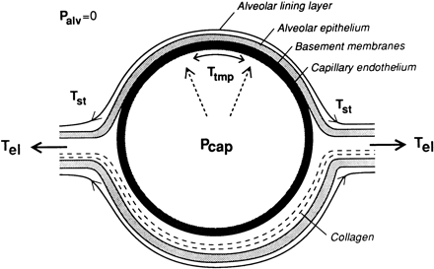
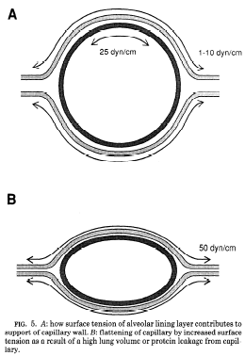
Do we need New Ventilation Modes?
Old problems not solved or new problems?
  Ventilator associated tracheitis (VAT) to ventilator associated pneumonia (VAP)
  Synchronisation problems
New patient population? Extreme age, size
  Neonati - very old – surgery less invasive
  Morbid obese - anorexia
New insight in physiology?
  Volutrauma is more important than barotrauma
  Permissive hypercapnia, permissive hypoxia, prevention of biotrauma

Slide 29
Do we have New Ventilation Technology?
Support matched with the patient demand: synchronisation problem: not for anesthesia
  Proportional assist ventilation (PAV)
  Neurally adjusted ventilatory assist (NAVA)
Breath-to-breath variability: improves oxygenation: more physiologic in anesthesia?
  Biologically variable ventilation (BVV)
  Fractal ventilation (FV)
Complex closed loop technology: ventilation is continuously adapted to the patient’s lungfunction: usefull in anesthesia?
  The adaptive support ventilation (ASV)

Slide 30
Do we have New Ventilation Technology?
Support matched with the patient demand: synchronisation problem: not for anesthesia
  Proportional assist ventilation (PAV)
  Neurally adjusted ventilatory assist (NAVA)
Breath-to-breath variability: improves oxygenation: more physiologic in anesthesia?
  Biologically variable ventilation (BVV)
  Fractal ventilation (FV)
Complex closed loop technology: ventilation is continuously adapted to the patient’s lungfunction: usefull in anesthesia?
  The adaptive support ventilation (ASV)

Slide 31
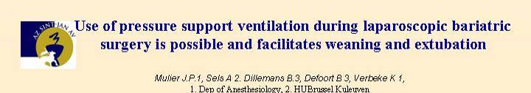

Post extubation aspiration due to
  Superficial breathing
    Use pressure support during end of operation
    Non invasive support ventilation
  Insufficient decurarization
    Use Brideon
  Not fully awake
    Use inhalation, remifentanyl, pressure support,…
  Stomach pouch not emptied
    Suction stomach empty before extubation

Slide 32
Can anesthesiology help to facilitate laparoscopic surgery?
Chirurgische opmerkingen
Patient spant en toch beweert Anesthesist dat patient ontspannen is (TOF 0) !
Ik heb geen werkvolume laparoscopisch en anesthesist wil niets doen!
Andere collega’s werken op lagere druk maar ik kan dat niet?
Sommige anesthesisten ontspannen patient beter dan anderen. Waarom?
Patient ademt en perst op einde ingreep terwijl ontwaak toch traag verloopt!

Slide 33
Why giving insufficient NMB?
Rest relaxation is very anxious,
To prevent bad respiration post op, low saturation, high CO2
Relaxation sufficient ended to allow neostigmine to work
  TOF minimum one count
Better no neostigmine as
  Bradycardia - total AV block risico
  Bronchospasm (asthmatic patients?)
  Vomiting and nausea post op
No reason now with Sugammadex (brideon)

Slide 34
On the abdominal pressure volume relation
Higher insufflation pressures needed
PV0 = 5
E = 4 mmHg/l
Insufficient intra abdominal volume
J Mulier, B Dillemans, M Crombach, C Missant, A Sels (2009)
On the abdominal pressure volume relationship.
The Internet Journal of Anesthesiology. 2009; 21: 1.

Slide 35
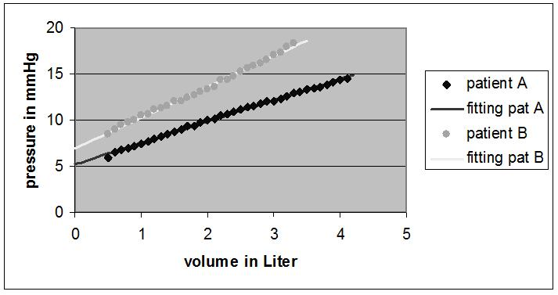
BMI effect on abdominal P/V relation
J Mulier ISPUB 2009
  Pressure volume relation is linear
  PV0 and E define each patient
J Mulier IFSO 2007

Slide 36
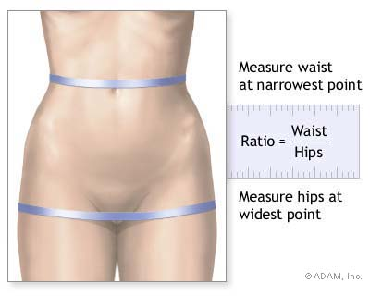

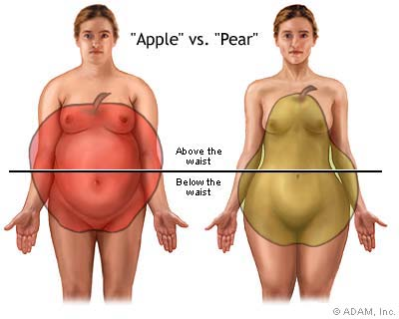
Waist to Hip ratio (WHR)
Man normal WHR: 0,9
Woman normal WHR: 0,7
Android fat distribution
  WHR > 0,8
Gynoid fat distribution
  WHR < 0,8

Slide 37
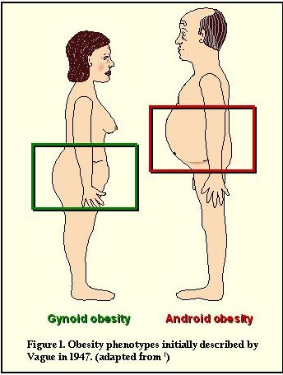
Android versus Gynoid fat distribution has a different Elastance

Slide 38

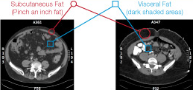
Two types of android obesity
Subcutaneus Fat Visceral fat
Intra visceral adiposity Extra visceral adiposity
Subcutaneus fat is scant and Subcutaneus fat is thick and
intra abdominal fat is thick and intra abdominal fat is scant.

Slide 39
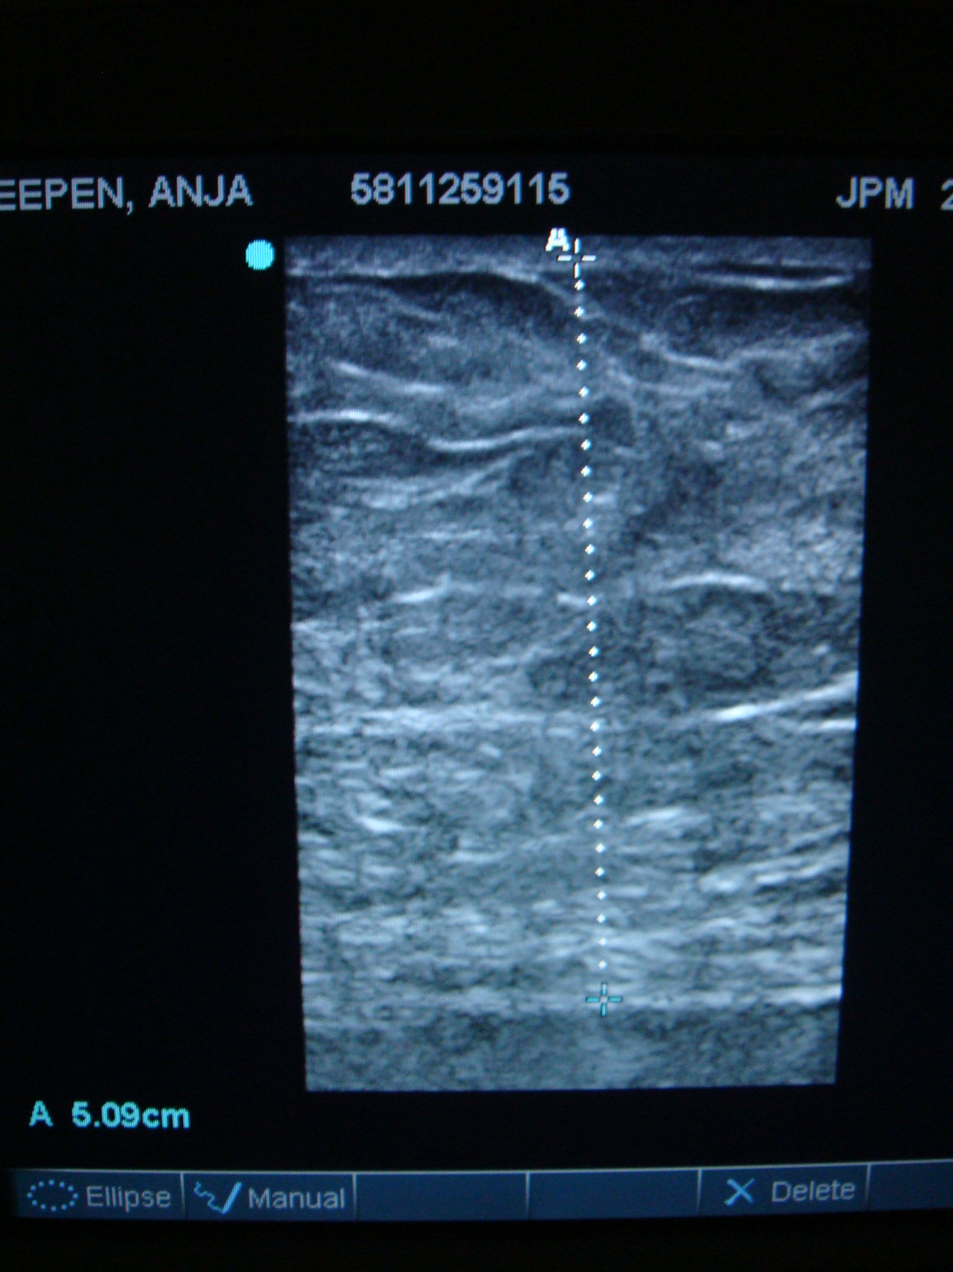
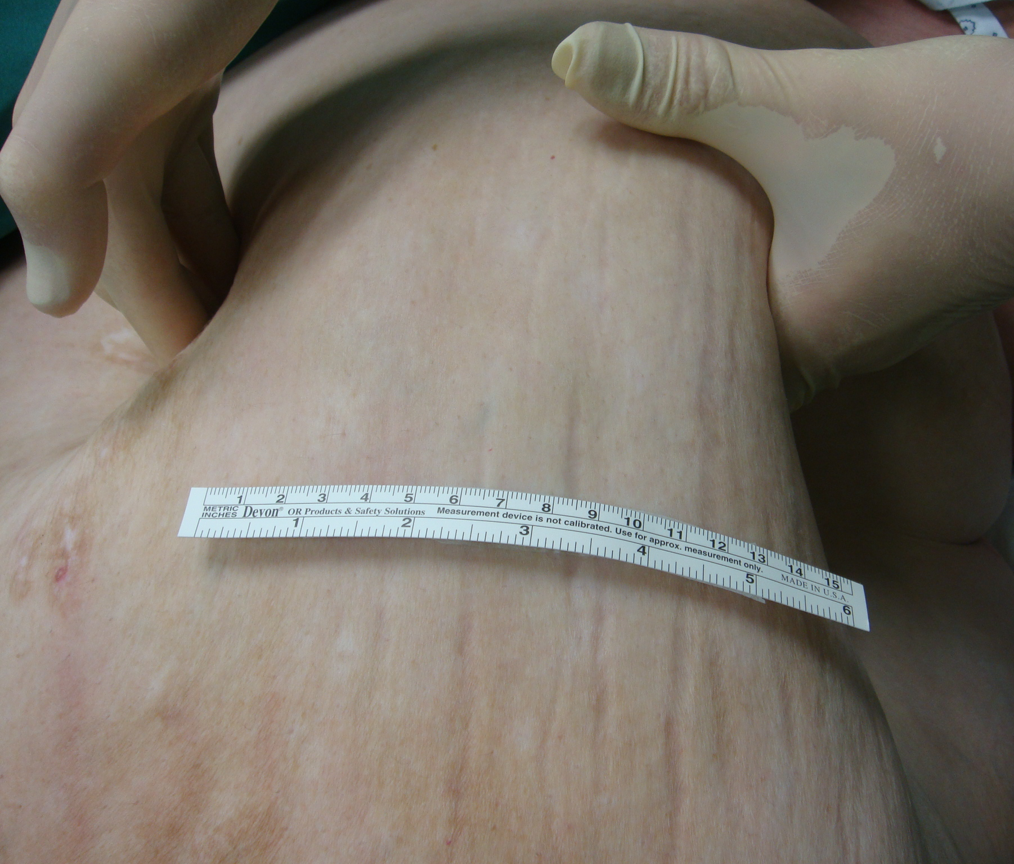
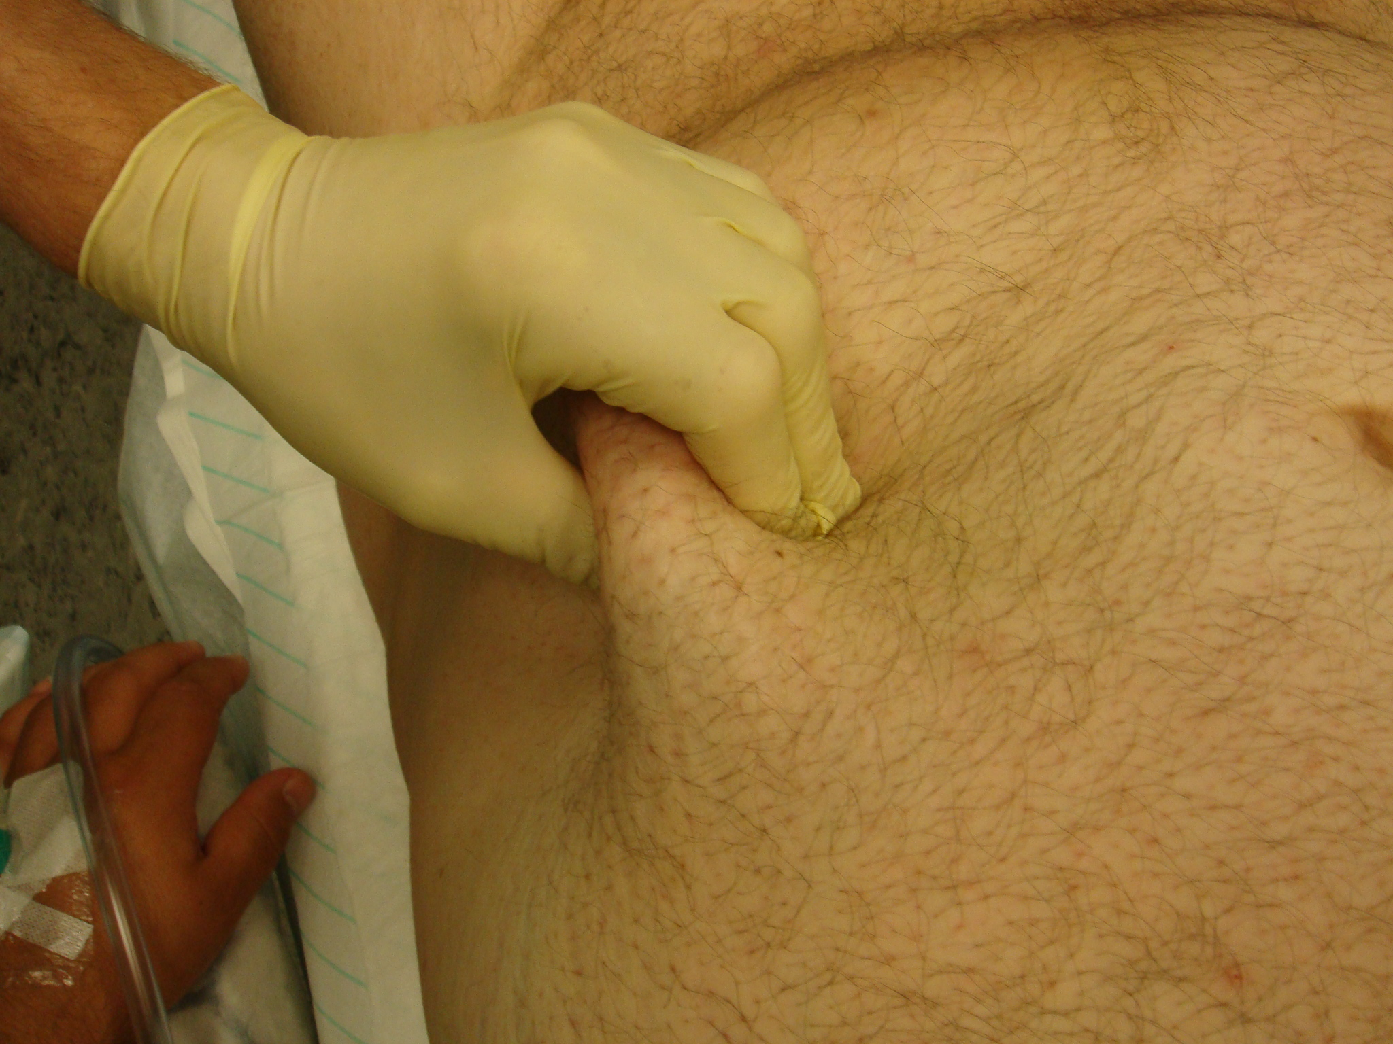
Dikte uitwendig/inwendig vet

Slide 40
How to predict risk?
TBW ? Equipment concern
BMI ? Indication, follow up
WHR ? Per and post op risk, but
Intra abdominal fat ? Yes but how to measure?
Higher risk: if BMI > 50 & WHR > 1.2 due to intra visceral fat.
  Need intensive care post op
  Weight reduction pre op
  Difficult to operate, to ventilate, to awake

Slide 41
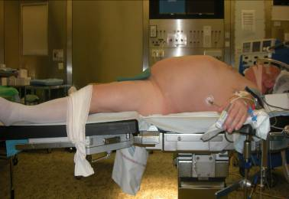
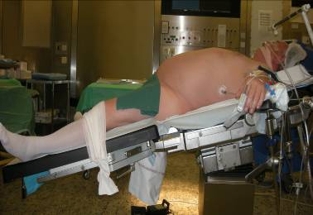
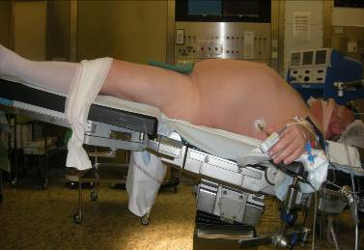
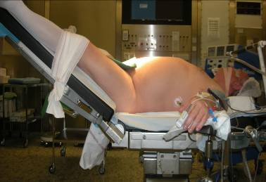
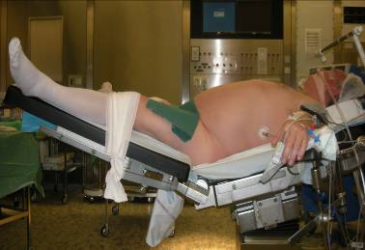
Comment changer E : flexion de la hanche
41
Mulier JP Cape Bruges 2011
Mulier JP Obes Surg 2009

Slide 42
Impact of patient’s body position on the intraabdominal workspace
Reverse trendelenburg Beach chair
E (mmHg/L) 3,6 2,6
PV0 (mmHg) 4,8 4,8
IAV (L) 2,99 3,76
Impact of the patient's body position on the intraabdominal workspace during laparoscopic surgery
.Mulier JP, Dillemans B, Van Cauwenberge S.
Surg Endosc. 2010 Jan 7. [Epub ahead of print]PMID: 20054583.

Slide 43
Begin – End of first laparoscopy
Abdominal compliance changes during pneumoperitoneum
Inflation volume rises more than 1 liter!
No NMB needed at end of operation ?
One Hour Laparoscopy at 15 mmHg
Elongates the Abdominal Wall
Mulier IFSO 2009

Slide 44
Laparoscopy without muscle relaxants ?
Laparoscopy is possible without NMB if
  Abdominal compliance > 0,5 L/mmHg
  IAV > 4 L at 15 mmHg at start laparoscopy
    Gravidity > 3
    Previous multiple laparoscopies/laparotomies
    > 10 kg weight reduction
    No man with android fat distribution
  After several hours abdominal compliance rises
  and
  Sufficient deep sleep
    As patient should not breath against ventilator.
  Pressure support ventilation
    Easier to prevent breathing against ventilator

Slide 45
Is deep relaxation needed and possible?
Time between end pneumoperitoneum and end operation is very short:
  in 5 min from TOF 0/4 -¼ till 90%
  is not possible with neostigmine.
Sugammadex
  TOF 0/4 till end pneumoperitoneum
  Very deep NMB PTC < 5 is possible till the end

Slide 46
Surgical workspace without - with NMB in one obese patient BMI 46:
PV0 = 9 mmHg drops to 6 mmHg. E remains constant at 2 mmHg/liter
Volume Pressure without NMB Pressure with NMB TOF 0
  1 liter 11 mmHg 8 mmHg
  2 liter 13 mmHg 10 mmHg
  liter 15 mmHg 12 mmHg
  liter - 14 mmHg
  Patient got inhalation Desflurane 1 Mac (what is having a little relaxation as well)
  Remifentanyl infusion with no effect on relaxation
  Ventilation 600 ml 12 x with 7 cm H20 peep
  Rocuronium bolus of 1,2 mg/kg IBW with continuous infusion of 50 mg/hour was given after first measurements
  Second measurements when TOF = 0 at the thumb
Pressure 14 gives volume of 4 liter
Workspace. View is more from above
More space and better access
Pressure 15 gives volume of 3 liter
Workspace.

Slide 47
Deep muscle relaxation is useful in morbid obese patients
TOF > 90%
TOF = 0/4 and PTC < 10
TOF 0/4 and PTC < 5
JPMulier 2008 ASA

Slide 48
NMB needed ?
Yes
  Larger surgical work-volume at lower pressures
  Workspace sometimes remains insufficient making surgeons angry : try to do everything.
  Prevent breathing against ventilator
  At low pressures less structural damage and less post op pain?
No
  Abdominal compliance sometimes large enough
  Work at higher intra abdominal pressure?
  2 MAC inhalation has same effect?
  Effect of position and of time?

Slide 49
Bridion dosage
Posttetanic
count
Twitch
response
Twitch
percentage
Level of block
Intense block
Deep block
Moderate block
Superficial block
Response to TOF
TOF count 0
TOF count 0
TOF count 1-3
TOF count 4
Response to PTC
PTC 0
PTC ≥1
T1/T4 %
Intense block: 16 mg/kg
Deep block: 4 mg/kg
Moderate block: 2 mg/kg
Superficial block: 1 mg/kg + Neostigmine?
No block: 0 mg/kg
PTC, posttetanic count; TOF, train-of-four.
Fuchs-Buder T et al. Acta Anaesthesiol Scand. 2007;51:789-808.
Notes:
49
This slide provides an explanation of the various depths of neuromuscular blockade.
Reference
1. Fuchs-Buder T, Claudius C, Skovgaard LT et al. Good clinical research practice in pharmacodynamic studies of neuromuscular blocking agents II: the Stockholm revision. Acta Anaesthesiol Scand. 2007;51:789-808.

Slide 50
Importance pour mesurer TOF
Les patients obèses sont plus difficiles à décurariser avec la neostigmine.
Suzuki Br J Anaesth 2006; 97: 160

Slide 51
T Bogaert, P Van Lancker, JP Mulier
ESA 2010 submitted
Reversal of neuromuscular block in 90 morbid obese patients BMI > 40
2 mg/kg from T1-T2 till TOF ratio ≥ 0.9
significant difference in time between first 3 groups
No difference between IBW+40% and TBW (p < 0.05) (one way ANOVA analysis)

Slide 52
Immediate Bridion effects
Deep breaths possible
  Less lung collaps
Aurosal effect
  Like Amfetamine awakening
  Sudden muscle fiber stimulation gives aurosal
Patient transfers him/her self in bed
  50 % of cases instead of only10%
Spontaneous movements easier
  Deep venous trombosis prevention
No non-invasive assist since introduction of sugammadex

Slide 53
Wat Chirurg antwoorden?
Patient spant en toch beweert Anesthesist dat patient ontspannen is !
  Fascia ontspan je niet met spierverslappers!
  kleine buikcompliantie is mogelijk
  Flexie van heup vergroot compliantie
  Beperk TV ventilatie, geen hoge peep
  Hoge dosis inhalatie (dubbel) zelfde effect als spierontspanners
  Laat pat spontaan ademen onder spierrelaxatie en hoge inhalatie conc met support dan perst hij nooit tegen!
  Maximale curarisatie met continu infuus tot einde en Bridion geven bij kleine buiken.

Slide 54
Gastric Bypass Anesthesie
Inductie
  DHB 1,25 mg
  Sufentanil 25 ug
  Propofol 200 tot 300 mg
  Esmeron 50 mg
Onderhoud
  Remifentanil 5/50 3ml/h tot 20 ml/h
  Esmeron infuus 3 ml/h tot 6 ml/h
  Inhalatie 1 mac Sevo of Desfl
  N20 is mogelijk ( maagsonde)
  Perfusalgan 2 gr daarna 1 gr alle 4u
See www.publicationslist.com/jan.mulier

Slide 55
ERAS 1 (early recovery after surgery)
Halfweg operatie
  Grote buik stop esmeron infuus,
  Kleine buik houd esmeron infuus aan tot einde laparascopie
Laatste stapler
  Verminder/stop remifentanyl infuus
  Start pressure support ventilatie
    Hypercapnic PSV increases CO and BP
Houd inhalatie conc hoog bij kleine buiken tot einde pneumoperitoneum.

Slide 56
PSV voorkomt tegenademen bij onvoldoende relaxatie
PSV is not a valsalva effect: IAV is not changing.
PSV is possible during deep muscle relaxation.
PROFOUND MUSCLE RELAXATION DOES NOT DISTURB
PRESSURE SUPPORT VENTILATION.
Mulier J, Blacoe D PGA 2009

Slide 57
ERAS 2
Lektest
  Hoog volume load
  SAP > 140 mmHg
    Et CO2 tot 60; PSV geef extra suf zo tachypnoe
    Ephedrine/phenylephrine bolus
  Doseer sufenta bij tot RR < 16
Laatste chirurgische steek
  Verminder verder PS, behoud peep
  Stop inhalatie
  TOF 4/4 <50% neostigmine
  TOF < 2/4 bridion dosis volgens TOF en IBW
    Geef bridion nadat patient op tafel vastgebonden is

Slide 58
Hypercapnic pressure support: easier SAP rise
Table | Normocapnic | Hypercapnic
SAP mmHg | 143 +/- 25 | 148 +/- 13
Et P CO2 mmHg | 39 +/- 7 | 53 * +/-6
CO L/min | 6,2 +/- 1,8 | 14,3 * +/- 2,9
Min Vol L:min | 9 +/- 1,3 | 7,6 *+/- 1,2
Ephedrine mg | 11 +/- 7 | 3 * +/- 3
J P Mulier (2008) Hypercapnic support ventilation during laparoscopic gastric bypass increases the cardiac output. Anesthesiology 2008 A174

Slide 59
Hypercapnic pressure support ventilation
Increases cardiac output
  Less wound infections
Lowers airway pressures
Resp freq: morfine if too low stop PSV
TV: curarisation corrected by support level
Improves saturation per op if low
Rapid awakening and spontaneous breathing
  Non surgical time between OP < 20 min
Less pain when awakening
  Extra doses given during end of surgery
Better post op breathing
  less post ventilation

Slide 60
ERAS 3
Reversed induction technique
  50 à 100 mg propofol in bolus
Maag leeg zuigen, mond leegzuigen
PSV naar Spont, TV > 200 ml
Extubatie halfzittend indien mogelijk
  Diep ademen, benen bewegen
  Nooit sedativa, benzodiazepines,…
  Voldoende pijn medicatie perop starten
Test: patient moet zich zelf verbedden 3 minuten na extubatie!
Turnover tijd tussen einde ingreep - incisie volgende patient < 20 minuten.

Slide 61
Standardization of the anesthesia for fully stapled laparoscopic Roux-en-Y gastric bypass for obesity
Pre operative preparation and questions.
Pre induction preparation.
Anaesthesia induction and maintenance.
Pneumoperitoneum induction and the need for muscle relaxation.
Ventilation of a morbid obese patient
Assisting the surgeon in positioning the gastric tube and performing the leak test.
Blood pressure increase to prevent postoperative bleeding and revision.
ERAS techniques to shorten turn over time and improve post operative recovery
Extubation, postoperative assist and the decision for intensive care follow up.
Post operative pain treatment
See www.publicationslist.com/jan.mulier

Slide 62
Schema bariatrie voor verpleging
1. Klaar leggen vooraf in de zaal:
  Spuitpomp met Esmeron (Rocuronium) 20 ml (aan 5 ml/h starten bij installatie in zaal)
  Spuitpomp met Ultiva (Remifentanyl) 5 op 50 ml in OP zaal (aan 5 ml/h starten bij binnenrijden zaal)
  3 way TIVA set verbinden op spuitpompen en perfusalgan op zijlijn via infuusset flushen. (driewegkraan dicht in perfusalgan fles steken en luchtledig laten zuigen, klem sluiten, luchtklep openen en druppelkamer vullen, klem terug openen en leiding vol laten zuigen, driewegkraan openen en verder lijn laten vullen.)
  Ephedrine 1/10 in 10ml spuit ‘markeren met zwarte lijn
  Neosynephrine 1/100 in 10 ml spuit (markeren met onderbroken zwarte lijn)
  Methyleenblauw minimum 4 ampoullen in 1000 ml oplossen.
2. Klaar legggen vooraf in pre anesthesie:
  DHB 1 ml in 2 ml spuit
  Esmeron 5 ml in 5 ml spuit
  Diprivan 20 ml ( tweede extra bij mannen met hoog BMI)
  Sufentanil 5 ml in 5 ml spuit ( tweede extra voor binnen)
  Dikke maagsonde 34 met opvangzak (swifel verpakking bewaren) en 150 ml spuit. Plooi zak met papier langs buiten en schuif afsluitklem over papier dat hier juist over past.
  Cefazoline 2 gr BMI > 40 anders 1 gr. Bij allergie peni Vanco 1 gr in 50 ml NaCl met debiet regelaar laten lopen over 1 h
  brede riemen aanwezig? Twee paar per zaal. Hextril voor mondspoeling
  KY gel op cuff ETT of Taperguard, mandrin beschikbaar, Cuff controller met connectielijn
  Mac 3 laryngoscoop blad, videolaryngoscoop klaar of weten waar.

Slide 63

Remember:Patient type with a high mortality risk apple WHR>1 intra, abd fat
Elderly male diabetes patient with hypertension and being super obese, no weigth loss.
  Buchwald 2007
Central abdominal fat, not stopped smoking, alcoholic
  General risk
Asthma and coronary artery disease
  Cardio pulmonary risks

